Slide 1

WELCOME
A PRESENTATION ON
BALLOON SHOOTER GAME

Slide 2


Team Members
Faria Ahmed
Abdullah Al Naim
Anisur Rahman
Ayesha Anisha
Member
ID : 2125051087
Member
ID : 2125051052
Member
ID : 2125051069
Member
ID : 2125051118

Slide 3
Introduction
A Python game where you burst balloons by clicking on them.
Burst as many balloons as possible to score points.

Slide 4
Tools & Technology
Programming Language: Python
Game Library: Pygame
Development Environment: Any Python IDE (e.g., PyCharm, VS Code)
System Requirements:
Python 3.x installed on the system
Pygame library installed via pip
e.

Slide 5
Project Features
Balloons float with random movements.
Players burst balloons by clicking on them.
Real-time score updates.
Game reset functionality.
Interactive and visually appealing interface
e.

Slide 6
How It Works
Balloons Movement:
Randomized floating based on trigonometric functions.
Burst Detection:
Checks mouse clicks within balloon boundaries.
Score Update:
Increases when balloons are successfully burst.
Game Reset:
Restarts game states and score.
.

Slide 7
Challenges Faced
Implementing Random Movement:
Used trigonometry for smooth animations.
Accurate Click Detection:
Developed robust collision detection logic.
Optimizing Gameplay:
Ensured smooth performance with multiple balloons on screen.

Slide 8
Graphics and Design
Balloon Appearance:
Balloons are drawn using pygame.draw.ellipse() with random colors.
A string is drawn using pygame.draw.line().
Mouse Pointer:
The pointer is drawn with lines forming a cross, changing color when over a balloon.
Background and Platform:
Background color: Light blue (lightBlue).
A dark gray platform is drawn at the bottom to represent the ground.

Slide 9
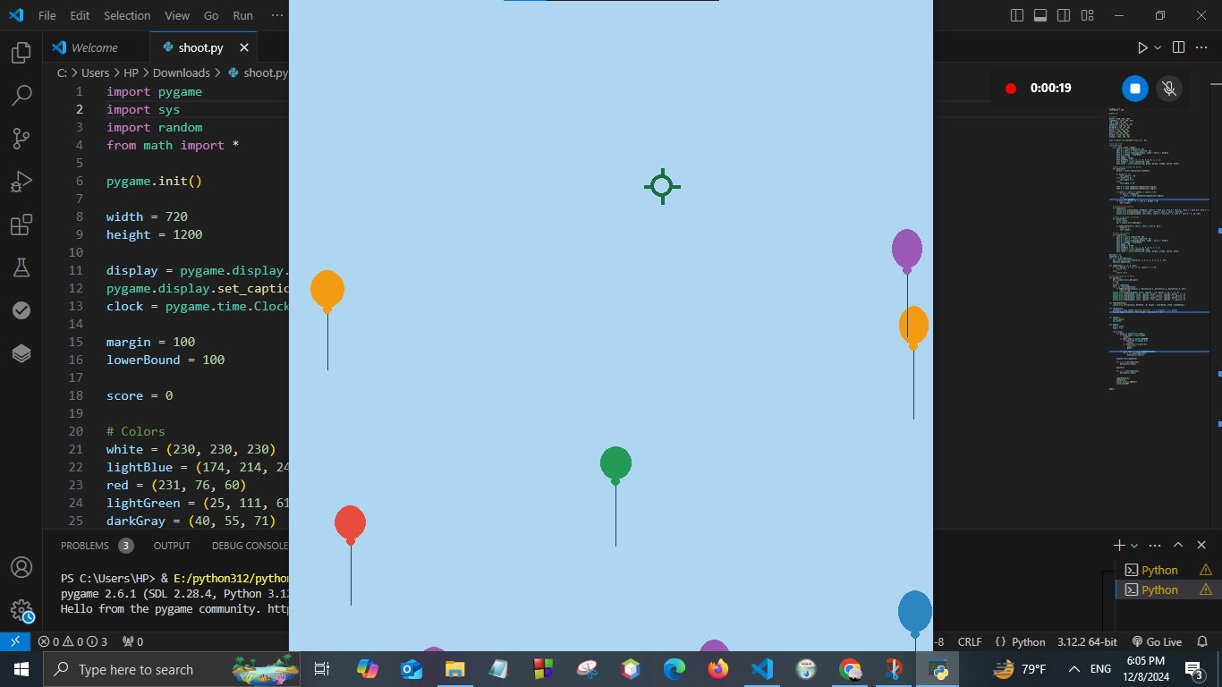
Final Result

Slide 10
Conclusion
The Balloon Shooter game is an interactive Python game using Pygame, where players pop balloons to earn points.
The game involves random balloon movement, user interactivity, and a dynamic scoring system.

Slide 11



Project Objectives
Analysis Phase
Strategy Development
Analyze sales performance, market trends, and consumer behavior.
Conduct a SWOT analysis of existing sales strategy.
Create new strategies using marketing, sales promotions,
Customer engagement to leverage strengths and opportunities.
Implementation Plan
Create a timeline with milestones
And responsibilities. Set KPIs to measure success.

Slide 12

Expected Outcomes
Increased Sales Figures:
Target a 25% increase in sales over the next years.
Measure success by tracking sales metrics and revenue growth.
Improved Customer Engagement:
Foster stronger relationships with customers through personalized engagement strategies.
Increase customer retention rates and loyalty.
Enhanced Market Reach:
Expand market reach by tapping into new demographics or geographical regions.
Strengthen brand presence through effective marketing campaigns.

Slide 13
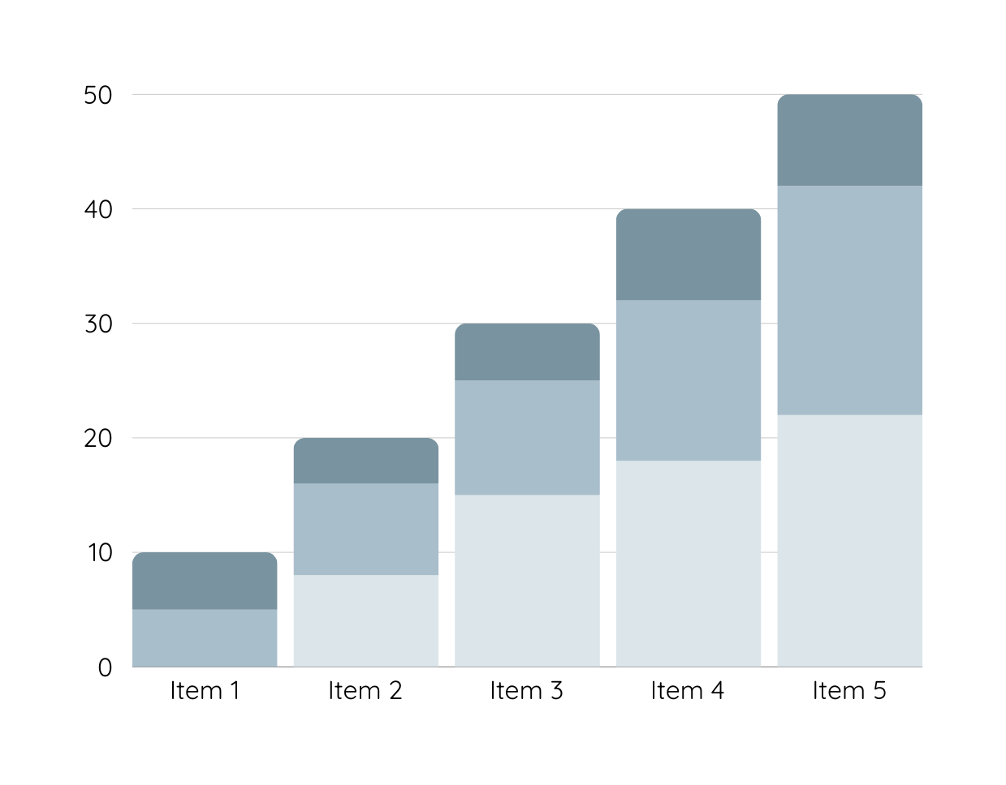
Data Analysis
Over the past year, sales for Warner & Spencer have experienced a consistent decline, dropping month-on-month. The graphical representation of sales volumes reveals a noticeable downward trend, especially in the last quarter.
Product 1
Product 2
Product 3

Slide 14
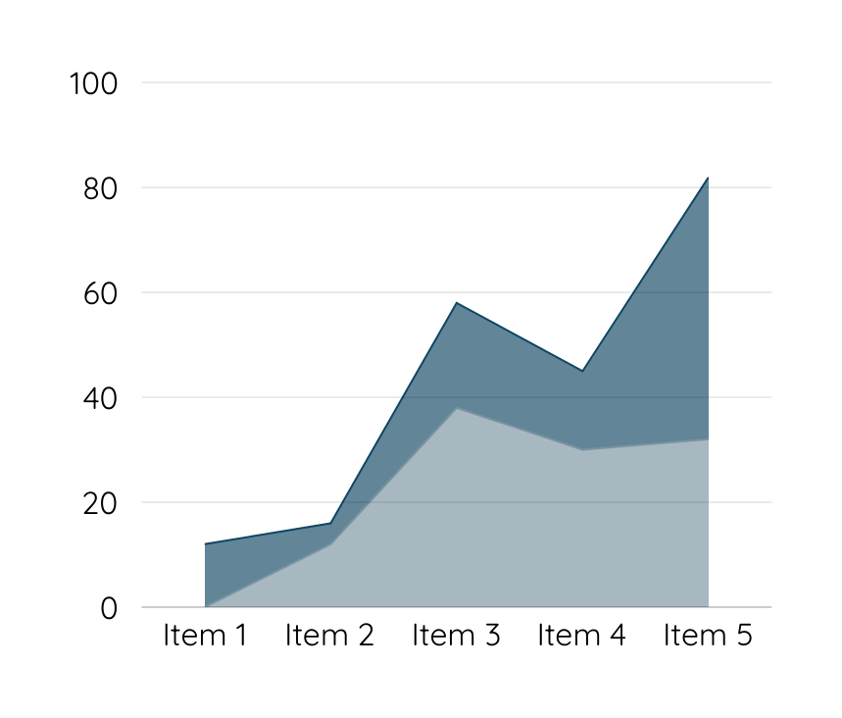
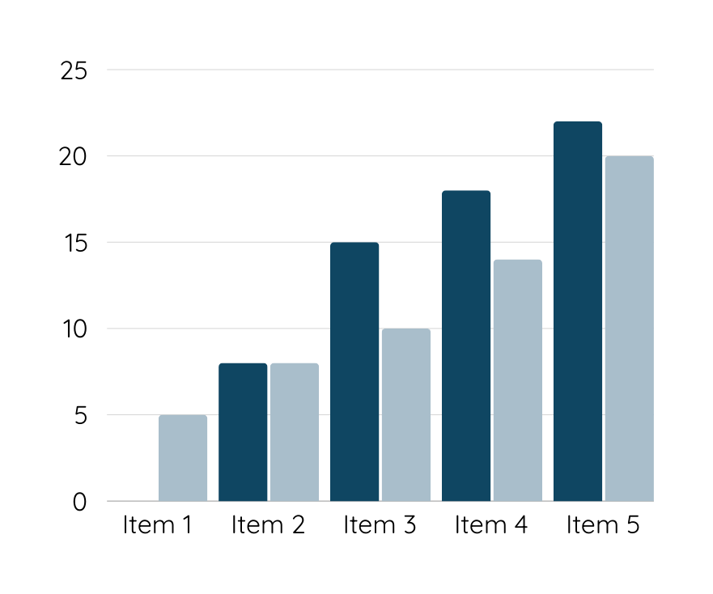
Data Analysis
Customers are unhappy with Warner & Spencer's new packaging, which may be contributing to a decline in sales. Competitors offer better features and pricing, making it difficult for our product to stand out in the market.

Slide 15
Thank you

